Slide 1
Dimensionality Reduction
Sourav Karmakar
souravkarmakar29@gmail.com

Slide 2
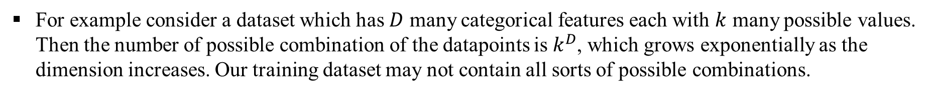
Dimensionality Reduction
Problem with very high dimensional data: Curse of Dimensionality
Data at very high dimensional space become sparse.
For highly sparse data Machine Learning algorithm doesn’t give satisfactory results always.
This is simply because the available training dataset might not account for every possible combinations of the features. Hence, ML algorithms struggles to find any meaningful relationship among the features and the target variables.
Work around of this problem
Dimensionality Reduction
To find a suitable representation of the data in lower dimensional space which will eventually help us for machine learning (classification/ clustering/ regression/ data-visualization).

Slide 3
Dimensionality Reduction
There are several types of dimensionality reduction techniques.
However, all those techniques can be broadly classified into two categories:
Feature Selection techniques
Feature Extraction techniques
Feature Selection techniques
We select few features based on certain criteria and thus get rid of redundant or less important features to make our dataset less bulky. Note that feature selection depends on the dataset as well as on the task we want to perform with the dataset.
Feature Extraction techniques
We project the original dataset which belongs to a high dimensional space to a low dimensional space such that the inherent information inside the data is not lost. This projection could be either linear and non-linear based on which we have linear or non-linear feature extraction techniques.

Slide 4
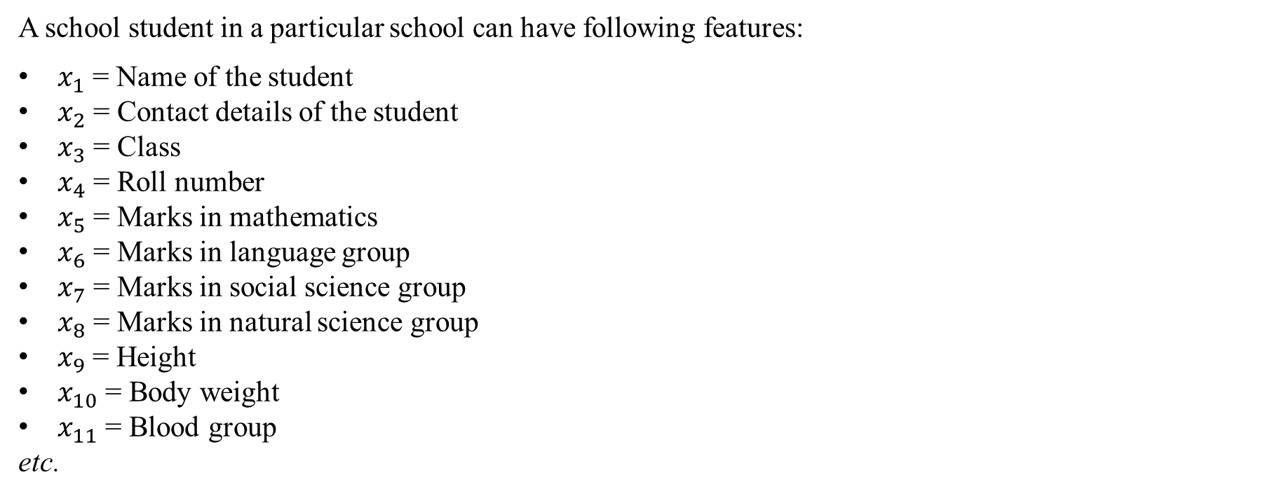
Dimensionality Reduction
A very simple example of Feature Selection:
Now let the job is to find suitable set of students for Science Olympiad. Which features play the important role in selecting the students for Science Olympiad?
Obviously in this case the most important features are: Marks in mathematics and marks in natural science group.
Now let us want to select the students for a sports tournament
In this case we have to select the students based on the height, weight, fitness, and skill in that particular sports.
Based on the problem in hand we can discard some of the features and consider others.

Slide 5
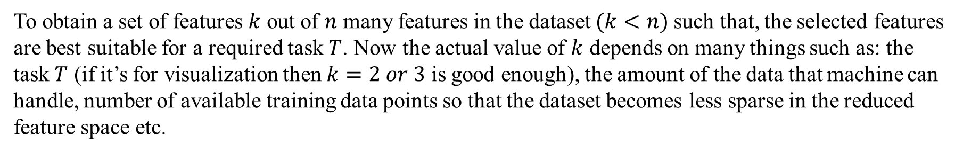
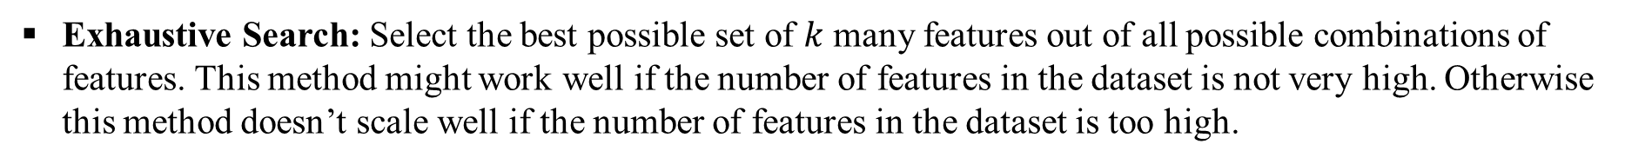
Feature Selection
Objective:
How to select the features:
Use domain knowledge and experience to select set of best features suitable for particular task.
Heuristic Search: In this case we keep on adding features which will provide best value of some criterion function. We stop the algorithm till the required number of features are selected.
Other search strategies such as Randomized Search are also used for feature selection.

Slide 6
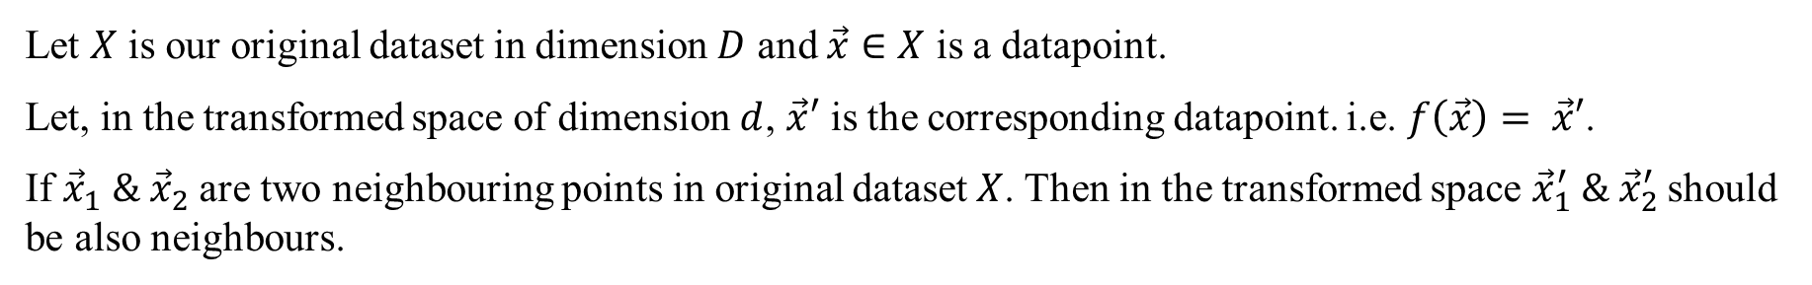
Feature Extraction
Here we are not selecting or discarding any particular feature. The whole idea is to project the dataset into some smaller dimensional subspace, such that the inter-relationship of the datapoints are preserved.
There are various Feature Extraction techniques. Few techniques employ linear transformation / projection of the dataset. For example: Principal Component Analysis (PCA) and Linear Discriminant Analysis (LDA). Some techniques involve non-linear transformation of the dataset. For example: Locally Linear Embedding (LLE) , Kernel PCA etc.

Slide 7
Mathematical Prerequisites
Eigenvalues & Eigenvectors

Slide 8


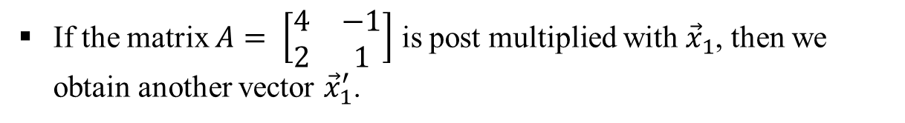




Matrix Vector Multiplication
So we can say that multiplying a vector with a matrix changes the direction and magnitude of the vector.
However for a given square matrix there are some vectors whose direction remain unchanged after multiplying with the matrix.

Slide 9
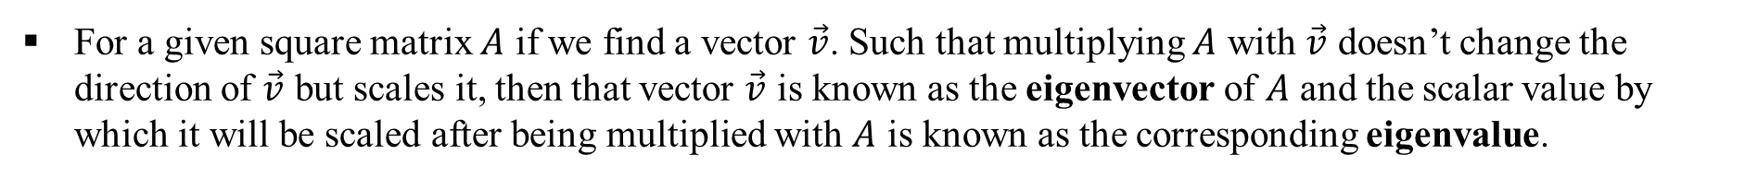
Eigenvalues And Eigenvectors
We can calculate the eigenvalues by solving the characteristic equation.
Putting the value of the eigenvalue one can calculate the corresponding eigenvectors.

Slide 10
Mathematical Prerequisites
Lagrange’s Multiplier

Slide 11





Constrained Optimization
The unconstrained optimization problem can be stated as:
Find the extreme value of y = f(x)
And to solve the problem we find the first derivative of y with respect to x and set that to zero.
In general a dependent variable could be functions of several independent variable. Then the unconstrained optimization problem is stated as: Find the extreme value of y = f(x₁ , x₂ , x₃ , … , x_{n} )
And to solve the problem we find the first derivative of y with respect to all independent variables and set those to zero.
However in real life we come across with the situations where we have to optimize the function subject to certain conditions (called the constraints).
Find the extreme value of y = f(x) ,
subjected to the condition g(x) = 0
This type of problems are known as constrained optimization problem.

Slide 12


Lagrange’s Multiplier
Find the extreme value of y = f(x) ,
subjected to the condition g(x) = 0
To solve the constrained optimization problem we formulate the Lagrangian as following:
Where, λ is a dummy variable known as Lagrange’s Multiplier. Then we take derivative of the Lagrangian and set that to zero to find the optimal value.
In general, there could be n many independent variables and m many constraints.
Find the extreme value of y = f(x₁ , x₂ , x₃ , … , x_{n} ) ,
subjected to: g₁(x₁ , x₂ , x₃ , … , x_{n} ) = 0 ; g₂(x₁ , x₂ , x₃ , … , x_{n} ) = 0 ; … ; g_{m}(x₁ , x₂ , x₃ , … , x_{n} ) = 0
Then the Lagrangian is formulated as following.

Slide 13


Lagrange’s Multiplier
Example: Maximize y = 5x₁x₂ , subjected to 2x₁ + x₂ = 100
Step-1: Formulate the Lagrangian. L(x₁, x₂, λ) = 5x₁x₂ - λ (2x₁+x₂-100)
Step-2: Take the partial derivatives of Lagrangian wrt x₁, x₂ and set them to zero.
Step-3: Along with these we make use of the constrained equation.
Step-4: Solving these three equations we get:
λ = | 125
x₁ = | 25
x₂ = | 50

Slide 14
Thank You

